Slide 1
Azure Data Lake
Rohit Shrestha
[Rohit@brainworks.edu.np]
Notes:
1

Slide 2
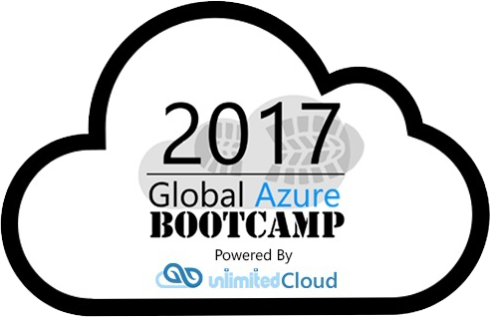

What is a Data Lake?
“A single store of all data… ranging from raw data (which implies exact copy of source system data) to transformed data which is used for various forms including reporting, visualization, analytics, and machine learning”
Notes:
Key point here is that data can be stored in raw source form and then transformed as needed to support various use cases. Data can exist in binary, tabular, document, delimited text, etc. form.
Not mentioned here is one of the key capabilities of ADL… the ability to federate data from external sources and query over it without explicit copying (which might be useful/necessary in situations involving sensitive or frequently changing data).
1

Slide 3
Azure Data Lake
Comprehensive, big-data storage + analytics platform
Purpose-built from real-world experiences
Office 365, Skype, Bing, etc.
Leverage existing skills and technologies
Benefits of an Azure-hosted service
Elastic, dynamically provisioned compute resources for varying query needs
Infinite storage capacity
Focus on extracting meaning from data, not on infrastructure
Notes:
Key points:
ADL was not invented out of thin air… based on real-world experiences of real-world product teams at Microsoft
Based on open-source technologies to which you can immediately apply existing skills like Pig, Hive, etc… AND/OR you can choose to opt into newer MS-specific offerings like U-SQL that offer unique features and potentially smaller learning curve
ADL abstracts infrastructure so that your analytics storage and jobs scale with your needs… literally Big Data-as-a-service
1

Slide 4
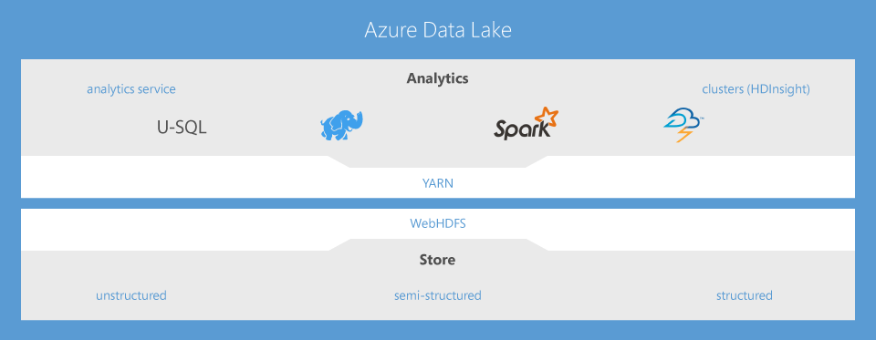
Built on Open-Source
jk
Notes:
ADL Store can be used on its own (without ADL Analytics)… its just “HDFS-in-the-cloud” at its heart.
Similarly ADL Analytics can be used without touching data in an ADL Store (to query storage blobs, or perhaps against federated SQL Databases).
Of course, they work very well together and will typically be used together.
1

Slide 5
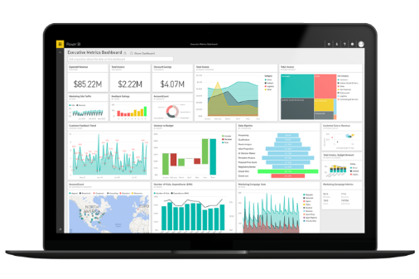
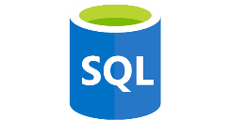
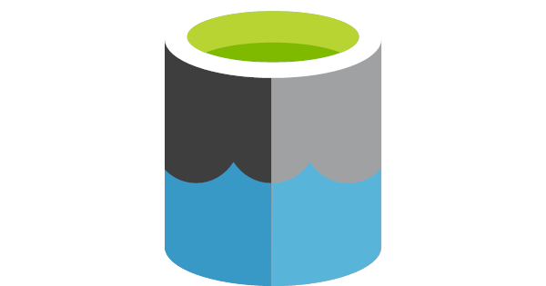
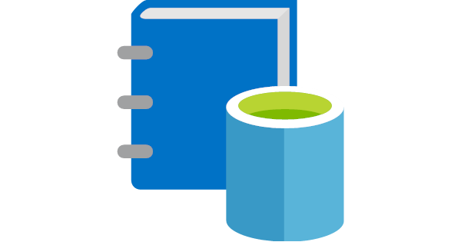


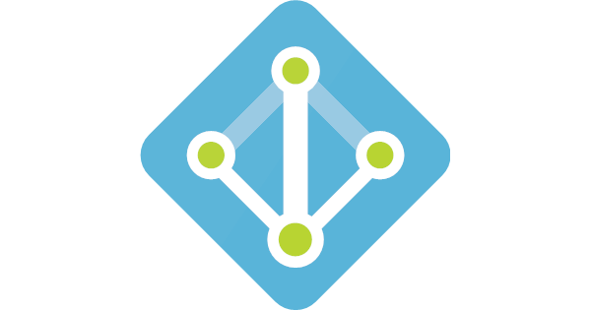
Azure Ecosystem Integration
Visualization
Federated SQL
Data Discovery
Data Import
Azure Data Lake
Security
jk
Notes:
Federate data from external sources - SQL Data Warehouse, SQL Database, IaaS-hosted SQL Server
Move data into Data Lake Store - Azure Data Factory for ETL, Azure Stream Analytics for streaming data
Power BI for query visualization
Azure Data Catalog for data publishing and discovery
Active Directory for user management and permissions
1

Slide 6
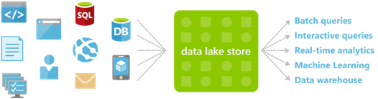
Azure Data Lake Store
HDFS-as-a-service
Durable, redundant storage
A variety of data scenarios
High capacity
High frequency
High throughput
Store data in its native format
Structured, semi-structured, unstructured storage formats
jk
Notes:
Beyond ADL Analytics, ADL Store can work as a source data repository for HDInsight; there are plans to further integrate it with other standalone open-source technologies in the Hadoop ecosystem like Spark, Storm, etc.
1

Slide 7



Azure HDInsight
Managed, cloud-scale Apache Hadoop-as-a-service
Full complement of Apache technologies
Spark, Storm, HBase, etc.
Focus on queries and data, not infrastructure
Pay for only what you need and use
Leverage existing skills and toolchains
Hive, Pig, Sqoop, R, etc.
jk
Notes:
HDInsight is based on the popular Hortonworks Hadoop platform and provides a wide range of data storage and analysis capabilities, ranging from real-time stream processing to OLTP, predictive modeling, and interactive analytics.
Like ADL Store and ADL Analytics, HDInsight abstracts away infrastructure configuration and management and lets you focus on core data analysis tasks like ingest, transformation, query, and visualization. It scales up or down automatically as data size and query complexity requires.
HDInsight also supports both Windows and Linux cluster types, which maximizes opportunities to port existing code and skillsets.
1

Slide 8
Azure Data Lake Analytics
Low-barrier alternative (or complement) to HDInsight and Hadoop ecosystem
Scales dynamically to match data size and query complexity
Built on Apache YARN
Unit of interaction is an analytics job
Elastic infrastructure management is abstracted away
U-SQL: query language rooted in SQL and C#
Notes:
http://hortonworks.com/apache/yarn/
“YARN is the architectural center of Hadoop that allows multiple data processing engines such as interactive SQL, real-time streaming, data science and batch processing to handle data stored in a single platform, unlocking an entirely new approach to analytics.”
From http://hadoop.apache.org/: “[YARN is] a framework for job scheduling and cluster resource management.”
The above also happens to be a good abstract description of ADL Analytics… it schedules and manages jobs and the cluster of machines used to execute those jobs. In the case of ADL Analytics a “job” is a U-SQL query issued against one or more configured data sources.
1

Slide 9
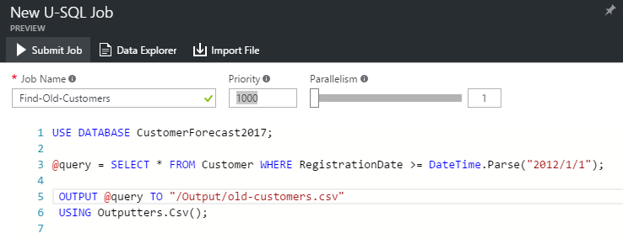
U-SQL
Based on SQL and C#
C# expressions and types
Tables, views, window functions, etc.
User-defined functions/operators/aggregators in C#
Typical job
Read data from file/table/federated source
Transform rowset in a pipeline
Output rowset to table or file
jk
Notes:
Good overview of U-SQL can be found here: http://usql.io/
“U-SQL is built on the learnings from Microsoft’s internal experience with SCOPE and existing languages such as T-SQL, ANSI SQL, and Hive. For example, we base our SQL and programming language integration and the execution and optimization framework for U-SQL on SCOPE, which currently runs hundred thousands of jobs each day internally. We also align the metadata system (databases, tables, etc.), the SQL syntax, and language semantics with T-SQL and ANSI SQL, the query languages most of our SQL Server customers are familiar with. And we use C# data types and the C# expression language so you can seamlessly write C# predicates and expressions inside SELECT statements and use C# to add your custom logic. Finally, we looked to Hive and other Big Data languages to identify patterns and data processing requirements and integrate them into our framework.”
1

Slide 10
Demo
jk

